Slide 1
Development Analysis of Africa
GROUP 1
Ava Riazi
Devang Jain
Vineet Balan
Anirudh Dave
Navneet Poddar
Pallavi Varandani

Slide 2
AGENDA
What is Development?
Data Discovery
Problem Statement
ETL Process Diagram
Product Demo
Conclusion

Slide 3
WHAT IS DEVELOPMENT?
Process of targeted activities and programs which helps in
improve the well being and quality of life
building local wealth
diversifying the economy
The Major Types of Development are
Economic
Social
Environmental
Political

Slide 4
DATA DISCOVERY
Source: WORLDBANK.ORG - 6 Datasets

Slide 5
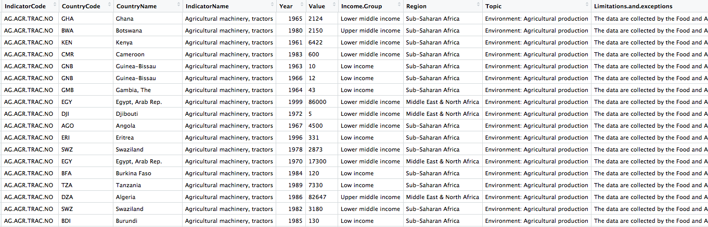
DATA DISCOVERY
Cleaned Dataset

Slide 6
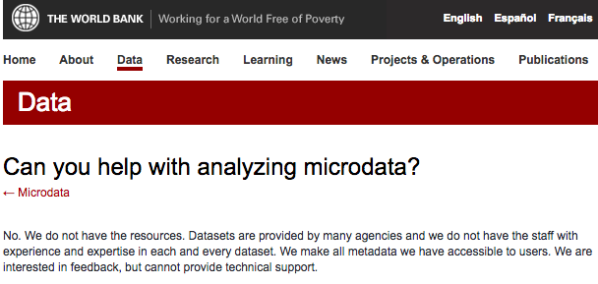
Problem Statement

Slide 7
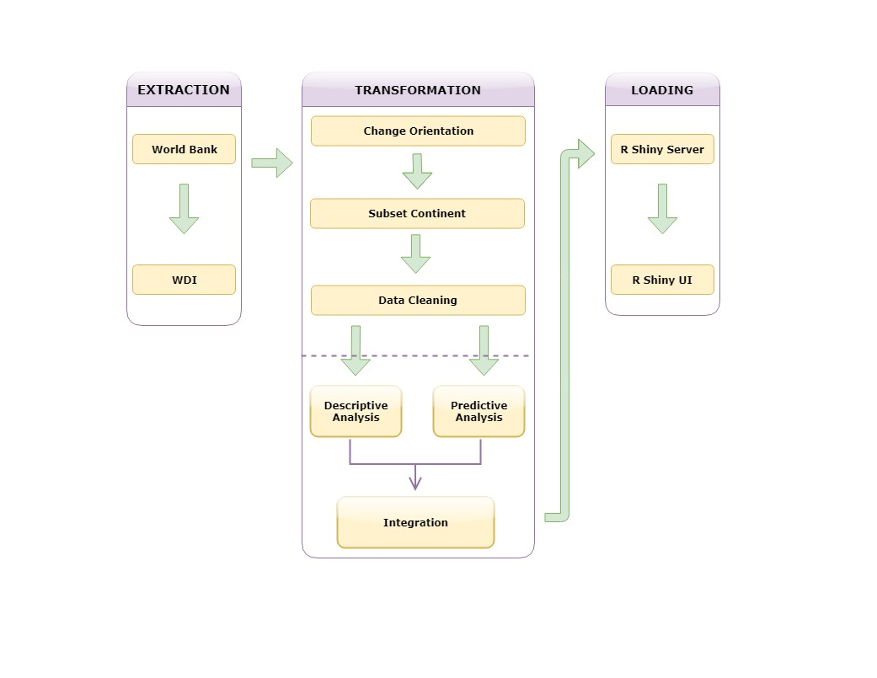
ETL Process Diagram

Slide 8
CONCLUSION
The Primary Business implication of our project is the tool itself. We have three major kind of users who would be benefited by this tool.
Government Body
It will help them in identifying where they are leading or lagging under specific areas of development which will aid in making broad development strategies.
Business Organization
They can identify the potential areas of investment by analysing the key indicators of development that are relevant for their company. Also it will help business’ seeking new markets.
United Nations
It will help them identify the under-developed country which require aid from UN & assisting them in allocating the resource.

Slide 9
Thank You!

